Slide 1
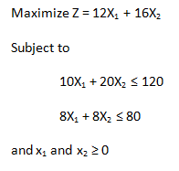

Slide 2
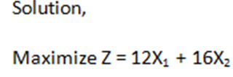








Slide 3
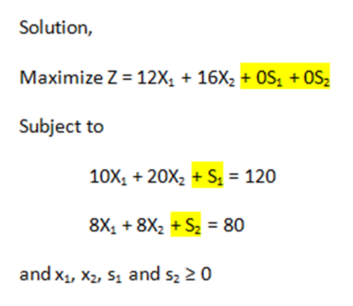

Slide 4
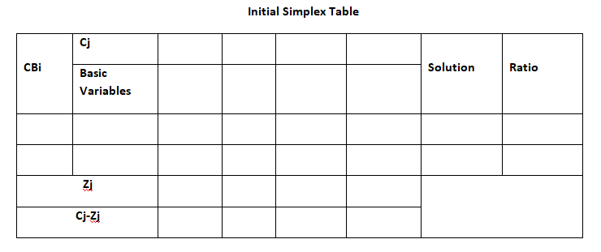
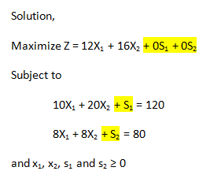
Entering Variable
Now, Select Cj-Zj with highest value.
Leaving Variable
Key Element
12
16
0
0
0
10
20
1
0
120
120/20 = 6
0
8
8
0
1
80
80/8 = 10
0
0
0
0
12
16
0
0
12-0
16-0
0-0
0-0
Since it is a maximization case, we can check if we have reached the optimal solution by finding if Cj-Zj≤0? If not, We Have not reached the optimal solution.
0*1+0*0=0
0*10+0*8 = 0
0*20+0*8 = 0
0*0+0*1=0

Slide 5
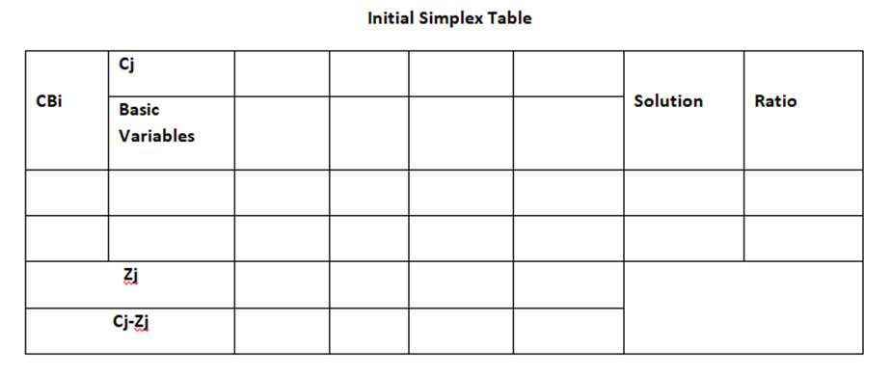
Entering Variable
Leaving Variable
12
16
0
0
16
0
0

Slide 6
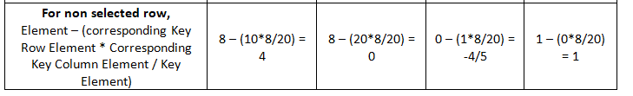
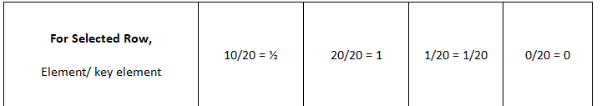
120 / 20 = 6
80- 120*8 / 20 = 32
12
16
0
0
16
10
20
1
0
120
0
8
8
0
1
80

Slide 7
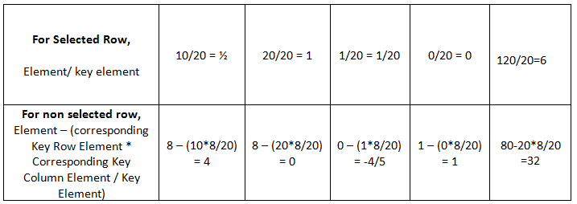

Slide 8
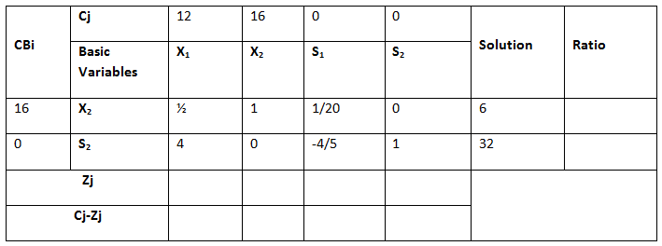
Key Element
Leaving Variable
Are All Cj-Zj≤0? No. Now, Select the Cj-Zj with highest value.
Entering Variable
6 / (1/2) = 12
32 / 4 = 8
8
16
4/5
0
96
4
0
-4/5
0
16*1/2 + 0*4 = 8
16*1 + 0*0 = 16
16*0 + 0*1 = 0
16*6 + 0 *32 = 96
16 * 1/20 + 0 *(-4/5) = 4/5

Slide 9
Is Cj-Zj≤0? If Yes, We have reached the optimal Solution.
12
16
0
0
16
0
1
1/10
-1/8
2
0
12
1
0
-1/10
1/4
8
12
16
2/5
1
128
0
0
-2/5
-1
X2=2
X1=8
Zj=128

